Slide 1
Stored Procedures & Injections

Slide 2
Functions
Functions in SQL Server are the database objects that contains a set of SQL statements to perform a specific task.
A function accepts input parameters, perform actions, and then return the result. We should note that functions always return either a single value or a table.
The main purpose of functions is to replicate the common task easily. We can build functions one time and can use them in multiple locations based on our needs.
SQL Server does not allow to use of the functions for inserting, deleting, or updating records in the database tables.

Slide 3
The following are the rules for creating SQL Server functions:
A function must have a name, and the name cannot begin with a special character such as @, $, #, or other similar characters.
SELECT statements are the only ones that operate with functions.
We can use a function anywhere such as AVG, COUNT, SUM, MIN, DATE, and other functions with the SELECT query in SQL.
Whenever a function is called, it compiles.
Functions must return a value or result.
Functions use only input parameters.
We cannot use TRY and CATCH statements in functions.

Slide 4
Types of Functions
SQL Server categorizes the functions into two types:
System Functions
User-Defined Functions
System Functions
Functions that are defined by the system are known as system functions.
In other words, all the built-in functions supported by the server are referred to as System functions.
The built-in functions save us time while performing the specific task.
These types of functions usually work with the SQL SELECT statement to calculate values and manipulate data.

Slide 5
Here is the list of some system functions used in the SQL Server:
String Functions (LEN, SUBSTRING, REPLACE, CONCAT, TRIM)
Date and Time Functions (datetime, datetime2, smalldatetime)
Aggregate Functions (COUNT, MAX, MIN, SUM, AVG)
Mathematical Functions (ABS, POWER, PI, EXP, LOG)
Ranking Functions (RANK, DENSE_RANK, ROW_NUMBER, NTILE)

Slide 6
User-Defined Functions
Functions that are created by the user in the system database or a user-defined database are known as user-defined functions.
The UDF functions accept parameters, perform actions, and returns the result.
These functions help us to simplify our development by encapsulating complex business logic and making it available for reuse anywhere based on the needs.
The user-defined functions make the code needed to query data a lot easier to write.
They also improve query readability and functionality, as well as allow other users to replicate the same procedures.

Slide 7
SQL Server categorizes the user-defined functions mainly into two types:
Scalar Functions
Table-Valued Functions
Scalar Functions
Scalar function in SQL Server always accepts parameters, either single or multiple and returns a single value. The scalar functions are useful in the simplification of our code

Slide 8
CREATE FUNCTION schema_name.function_name (parameter_list)
RETURNS data_type AS
BEGIN
statements
RETURN value
END
Example
CREATE FUNCTION udfNet_Sales(
@quantity INT,
@price DEC(10,2),
@discount DEC(3,2)
)
RETURNS DEC(10,2)
AS
BEGIN
RETURN @quantity * @price * (1 - @discount);
END;

Slide 9
SQL Server also allows us to modify the scalar function by using the ALTER keyword. Here is the syntax to do this:
ALTER FUNCTION schema_name.function_name (parameter_list)
RETURNS data_type AS
BEGIN
statements
RETURN value
END
We can use the below statement to remove the scalar function from the SQL Server database:
DROP FUNCTION [schema_name.]function_name;

Slide 10
Table-Valued Functions
Table-valued functions in SQL Server are the user-defined function that returns data of a table type.
Since this function's return type is a table, we can use it the same way as we use a table.
Inline Table-Values Functions
This UDF function returns a table variable based on the action performed by the function. A single SELECT statement should be used to determine the value of the table variable.

Slide 11
--It creates a table-valued function to get employees
CREATE FUNCTION fudf_GetEmployee()
RETURNS TABLE
AS
RETURN (SELECT * FROM Employee)
SELECT * FROM udf_GetEmployee();
Multi-statement table-valued functions (MSTVF)
CREATE FUNCTION MULTIVALUED()
RETURNS @Employee TABLE
(id INT, emp_name VARCHAR(50), salary INT) AS
BEGIN
INSERT INTO @Employee
SELECT E.id, E.emp_name, E.salary FROM Employee E;
UPDATE @Employee SET emp_name = 'Graeme Smith' WHERE id = 3;
RETURN
END
SELECT * FROM MULTIVALUED();

Slide 12
Stored Procedure
A stored procedure is a group of one or more pre-compiled SQL statements into a logical unit.
It is stored as an object inside the database server.
It is a subroutine or a subprogram in the common computing language that has been created and stored in the database.
Each procedure in SQL Server always contains a name, parameter lists, and Transact-SQL statements.

Slide 13
SQL Server builds an execution plan when the stored procedure is called the first time and stores them in the cache memory.
The plan is reused by SQL Server in subsequent executions of the stored procedure, allowing it to run quickly and efficiently.
Example
CREATE PROCEDURE studentList
AS
BEGIN
SELECT name, age, salary
FROM STUDENT
ORDER BY salary;
END;
We can execute this procedure :
EXEC studentList;

Slide 14
SELECT * FROM sys.procedures;
The best way for listing all user-defined stored procedures in a database is to use the ROUTINES information schema view as below:
SELECT ROUTINE_SCHEMA, ROUTINE_NAME
FROM INFORMATION_SCHEMA.ROUTINES
WHERE ROUTINE_TYPE = 'PROCEDURE';
OR,
SELECT *
FROM db_name.INFORMATION_SCHEMA.ROUTINES
WHERE ROUTINE_TYPE = 'PROCEDURE'
Another way to return a list of stored procedures is to query the sys.objects system catalog view.
SELECT
SCHEMA_NAME(schema_id) AS [Schema],
name
FROM sys.objects
WHERE type = 'P';

Slide 15
Creates a stored procedure with an input parameter:
CREATE PROCEDURE getEmployeeDetails (@States VARCHAR(50))
AS
BEGIN
SET NOCOUNT ON;
SELECT c_name, email, state
FROM customer
WHERE state = @States
END

Slide 16
Output Parameters in Stored Procedure:
CREATE PROCEDURE countStudent (@StudentCount INT OUTPUT)
AS
BEGIN
SELECT @StudentCount = COUNT(Id)FROM STUDENT;
END;
Now, we will execute the stored procedure. Here, we need to pass the output parameter @StudentaCouns as follows:
-- Declare an Int Variable that corresponds to the Output parameter in SP
DECLARE @TotalStudents INT
-- Don't forget to use the keyword OUTPUT
EXEC [dbo].[countStudent] @TotalStudents OUTPUT
-- Print the result
PRINT @TotalStudents

Slide 17
Temporary Stored Procedure
We can create temporary procedures in the same way as we can create temporary tables.
The tempdb database is used to create these procedures.
We can divide the temporary procedures into two types:
Local Temporary Stored Procedures
Global Temporary Procedures.
Local Temporary Stored Procedures:
We can create this type of procedure by using the # as prefix and accessed only in the session in which they were created.
When the connection is closed, this process is immediately terminated.

Slide 18
CREATE PROCEDURE #Temp
AS
BEGIN
PRINT 'Local temp procedure'
END
Global Temporary Stored Procedure:
We can create this type of procedure by using the ## as a prefix and accessed from any sessions.
When the connection that was used to create the procedure is closed, this procedure is automatically terminated.
CREATE PROCEDURE ##TEMP
AS
BEGIN
PRINT 'Global temp procedure'
END

Slide 19
SQL INJECTION
SQL Injection is a technique where SQL commands are executed from the form input fields or URL query parameters.
This leads to unauthorized access to the database (a type of hacking).
If SQL injection is successful, unauthorized people may read, create, update or even delete records from the database tables.

Slide 20
SQL Injection Using Multiple Statement
$prod_id = $_GET["prod_id"];
$sql = "SELECT * FROM Products WHERE product_id = " . $prod_id;
If user submits 20, how SQL is interpreted,
SELECT * FROM Products WHERE product_id = 20

Slide 21
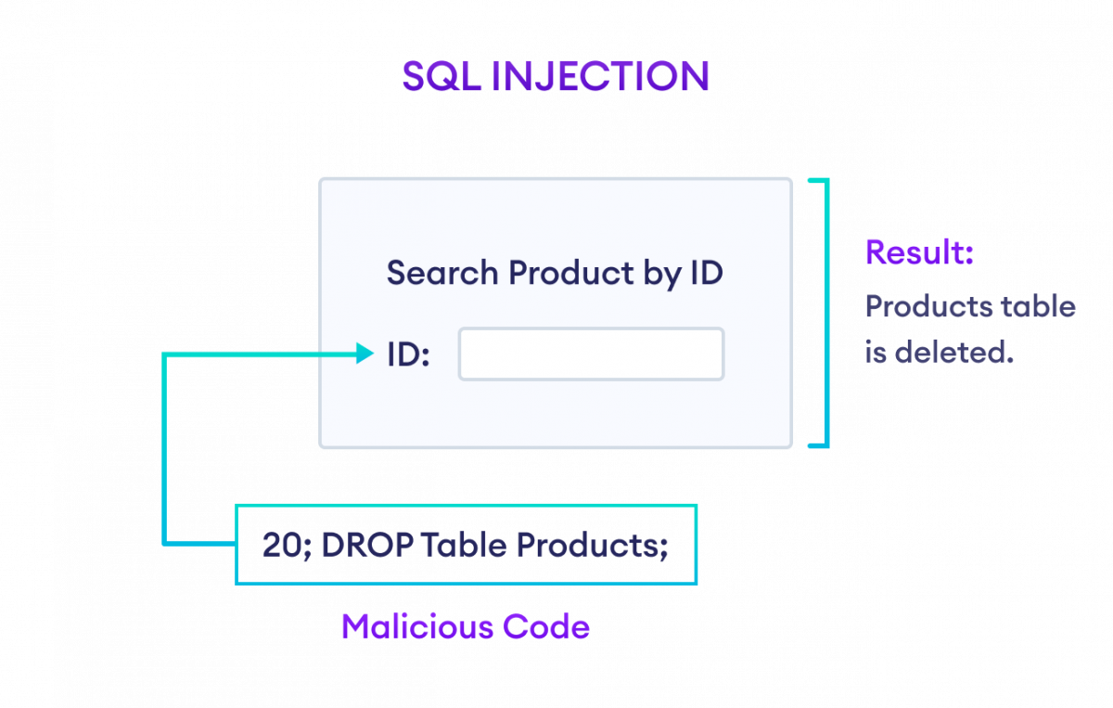
Nothing suspicious, right?
What if user inputs 20; DROP TABLE Products;? Let's take a look at SQL statement again,
SELECT * FROM Products WHERE product_id = 20; DROP TABLE Products;

Slide 22
SQL Injection Using Always True Condition
Another way to perform SQL injection is by passing a condition that always results in TRUE so that the data is always fetched no matter what.
What if the user inputs username as invalid_user" OR "1"="1 and password as invalid_pass" OR "1"="1? Let's take a look at how SQL interprets.
SELECT * FROM Users WHERE username = "invalid_user" OR "1"="1" AND password = "invalid_pass" OR "1"="1"

Slide 23
How to Protect SQL Statements From Injections?
Validate User Input
Always validate user's input data before actually sending them to the database.
Some best practices include, trimming spaces, parsing special characters, limiting the input size, etc.

Slide 24
Using ORMs
ORM (Object Relational Mapping) is a tool that basically parses SQL statements into programming language code and vice-versa.
For example,
SELECT * FROM Users WHERE id = 5;
will look like
select(Users).where(Users.id == 5)

